Slide 1



Universal Remote Observation of Coral Health (UROCH)
Studying the Efficacy of Extending Existing NASA Instruments to Detect and Monitor Coral Reefs
University of Rochester Data Science Capstone
12/06/2022
Presented by
Lisa Pink Matthew Johnson Mohamad Ali Kalassina Patrick Geitner Thomas Durkin

Slide 2
INTRODUCTION & PROJECT LOGISTICS

Slide 3
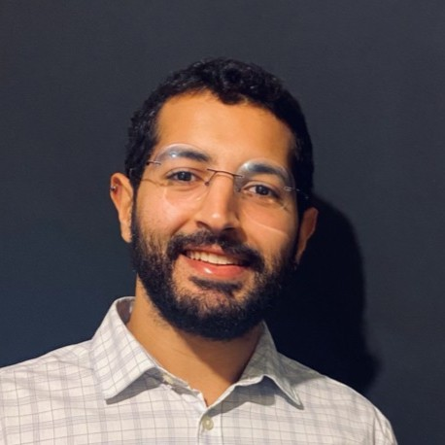
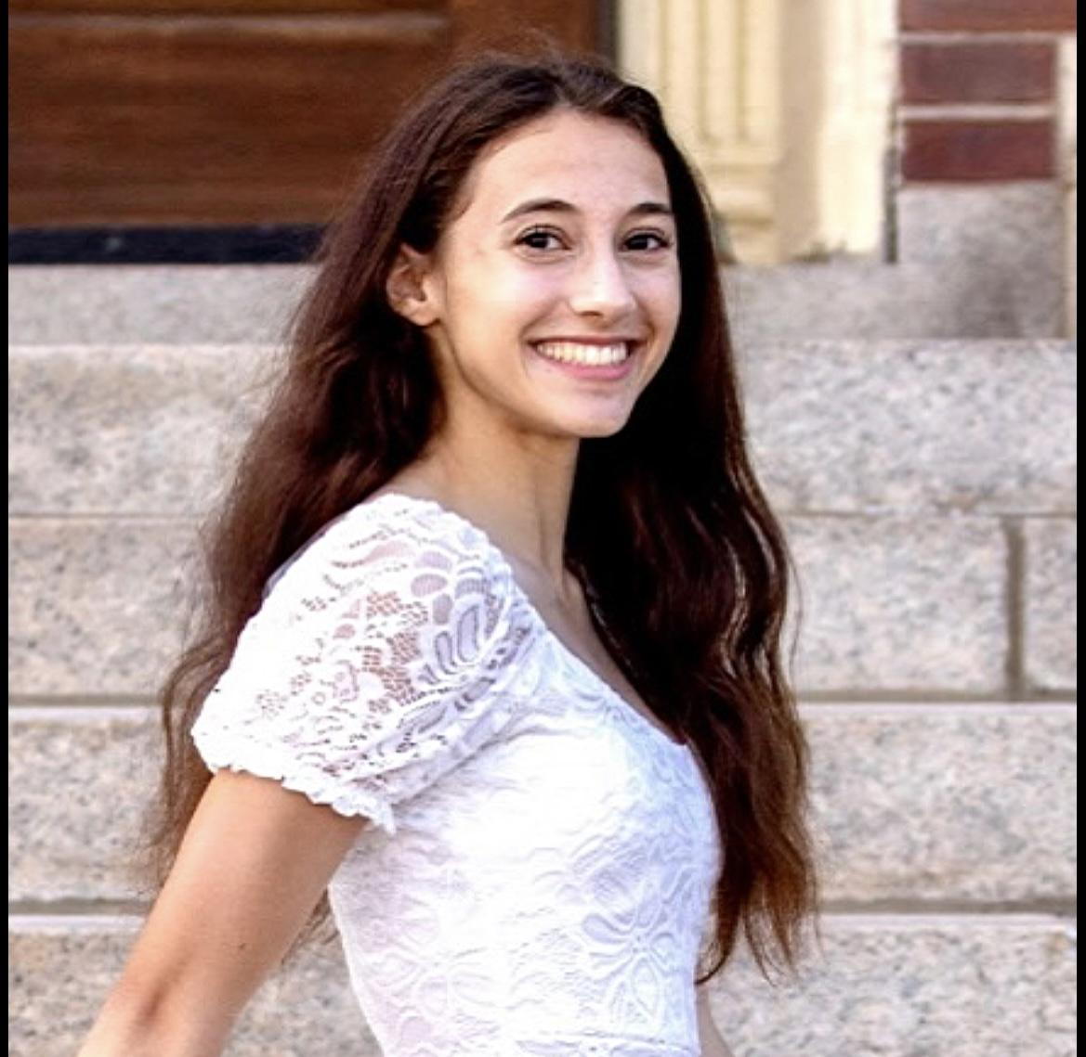
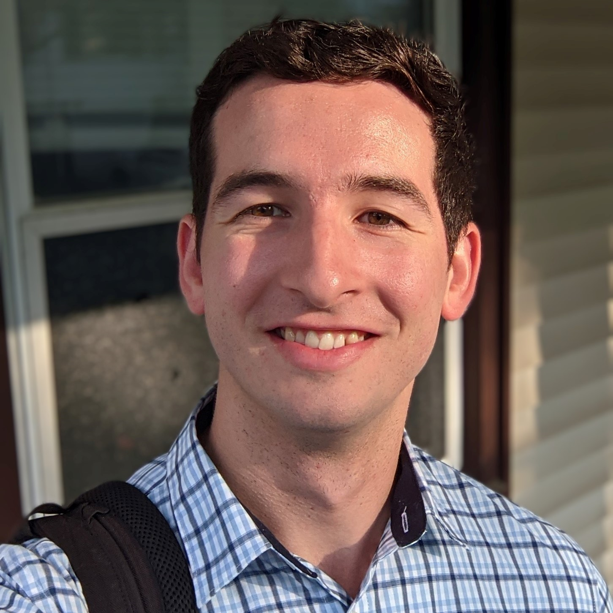
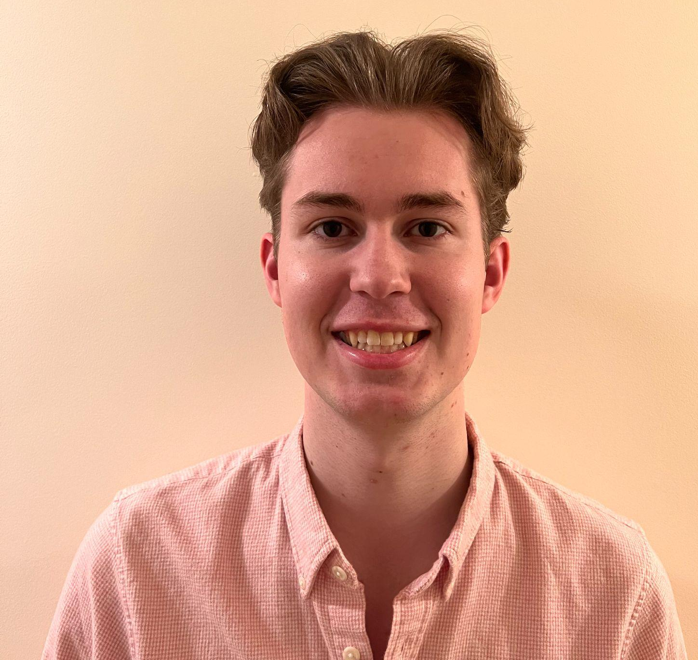


Presentation Agenda
1
Introduction & Project Overview
1
2
Data Sources & Acquisition
1
Exploratory Data Analysis
3
Data Pre-processing and Fusion
1
Lisa
Matthew
4
Modeling Approaches & Results
1
5
Conclusion & Key Insights
1
6
Limitations & Future Considerations
1
6
Highlights & Acknowledgements
Mohamad Ali
Thomas
Patrick
1
Notes:
Our project follows the data science project life cycle very closely. We will start with an introduction about the problem we’re solving, move on to data sources, data fusion, the different modeling approaches adopted, and wrap up with an evaluation of our models and describe next steps. Here is a quick overview of the team as well!

Slide 4




Introduction / Background
1
What are coral reefs?
Why are they important?
What is the problem?
one of most biodiverse ecosystems on the planet
Coral reefs are made up of colonies of hundreds to thousands of tiny individual corals
SUPPORT 25% OF ALL MARINE LIFE
50% already dead
OVER 90% TO DIE BY 2050
small marine animals that attach themselves to rocks, with some types building a hard skeleton.
GENERATE $30 BILLION/YR THROUGH COASTAL PROTECTION, FISHERIES, AND TOURISM
What are we doing to address it?
there are more than 2,000 identified species
REDUCE WAVE ENERGY BY 97%
Notes:
-2000 species - which is an important consideration as it adds layers of difficulty in identifying corals in different parts of the world
-according to coral vita,Scientists project that due to climate change and direct human impacts, over 90% of coral reefs will be dead by 2050.
What are we doing to address it? This leads us to our project vision and goals.

Slide 5
Project Vision & Goals
Project Vision and Goals
Project Vision
Use NASA satellite data to identify regions where coral reefs exist and evaluate their health and vitality - creating a baseline for future coral reef monitoring
Goals
Data Acquisition
Data Fusion
EDA & Feature Engineering
Model & Evaluate
Identify and access open source satellite and coral data
Narrow down geographic scope of the project
Consolidate satellite and coral data sources separately and merge features
Temporal and spatial alignment of coral and satellite data combined
Define indicators/metric that identify changes in reef health through exploratory data analysis
Develop and evaluate predictive model that evaluates coral reef health in the area of study
Extract and summarize insights from model prediction as a baseline for future coral reef monitoring
Outcomes This goal of this project is twofold, using two models to achieve two major outcomes:
Model 1: Coral Presence
Using satellite data and benthic map data, the goal of Model 1 is determine whether or not coral is present in an area. This model begins with classifying coral and algae together, and then further classifies as either coral or algae.
Model 2: Bleaching Severity
Given that a point from Model 1 was classified as coral, the goal of Model 2 is to use bleaching data and satellite data with added engineered features to determine bleaching severity of a point.

Slide 6
SCHEDULE - MILESTONES

Slide 7
1
Project Milestones
Collecting the data and developing framework for data fusion
First demonstration of combined data sources and fusion algorithms to NASA team
Output analysis from model training and model tuning/improvement
Report draft for NASA and NASA presentation
Creating Project Charter and getting approval from the NASA team
Developing code for data cleaning and fusion and executing it
GIDS Final presentation: demonstration of data fusion algorithms, combined data sources, and machine learning models
Finalize report, Github, and deliverables
Developing the model selection, training, and evaluation pipeline & Midterm presentation
September
October
November
December

Slide 8
TECHNICAL APPROACH & RESULTS

Slide 9
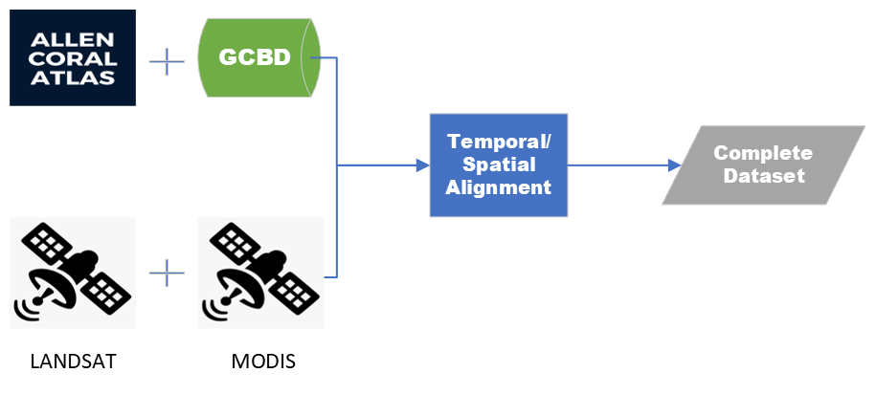
Overall Data Fusion

Slide 10
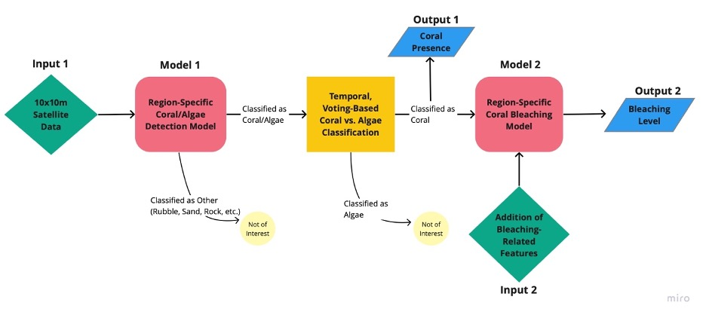
Overall System Architecture

Slide 11
MODEL 1: CORAL PRESENCE

Slide 12
Model 1: Coral Presence
Coral/Algae Detection

Slide 13
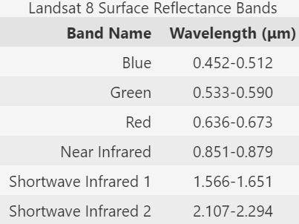
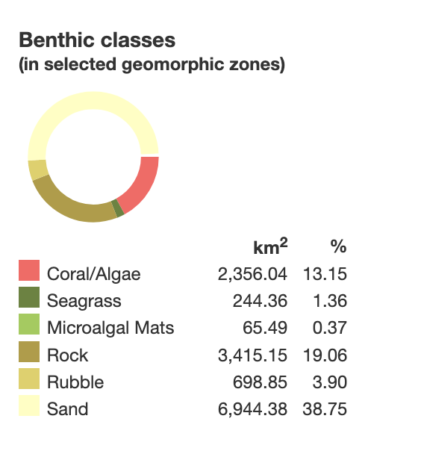
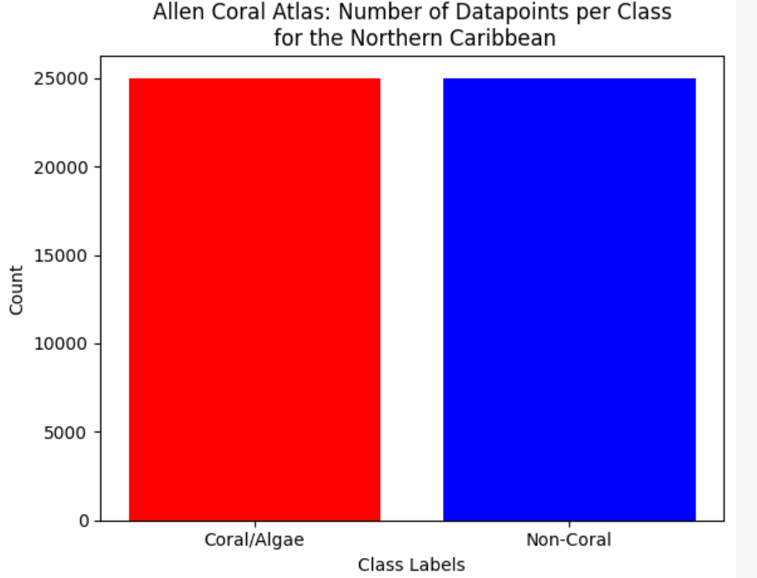
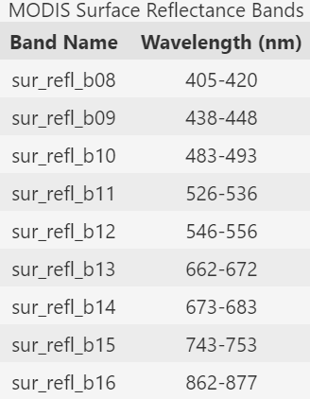
Model 1- Coral Presence
Datasets
Coral Dataset: Allen Coral Atlas (ACA) benthic map
Satellite Datasets: Landsat 8, MODIS
Data is filtered down to two regions:
Northern Caribbean, Florida, and Bahamas
Great Barrier Reef
Above is the benthic class data breakdown from the Northern Caribbean region of the Allen Coral Atlas

Slide 14
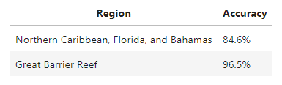
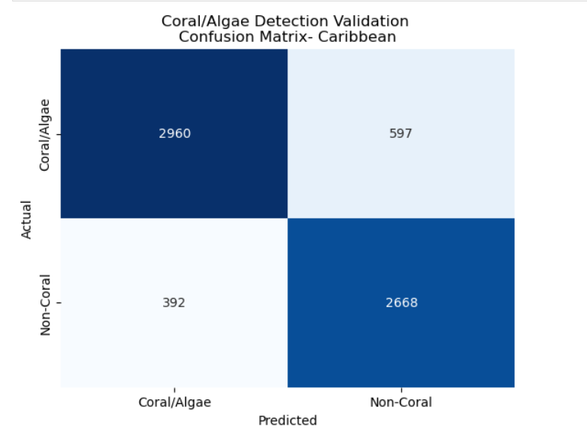
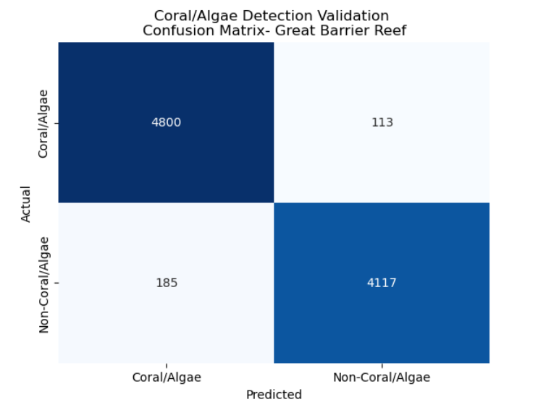
Model 1- Coral Presence
Coral/Algae Detection
XGBoost Architecture
Features
Surface reflectance bands
Landsat spectral indices
Large decrease in accuracy when training/testing
on two different regions
Snapshot of Model Accuracy for each of the Regions Studied

Slide 15
Model 1- Coral Presence
Distinguishing Between Coral and Algae

Slide 16
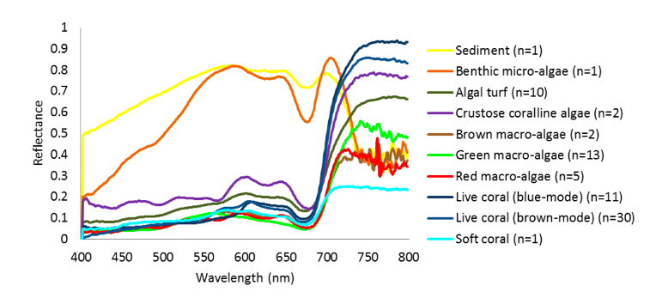
Distinguishing Between Coral and Algae
Problem: Coral and algae have extremely similar spectral signatures and are hard to tell apart from a single snapshot of satellite data
There is very little data that reliably distinguishes between coral and algae, making model-based classification methods intractable
Spectral Signature of Various Coral and Algae Species (Leiper 2014)
Spectral reflectance signatures measured in the ocean at a distance of 5cm - much harder to distinguish from satellites in orbit

Slide 17
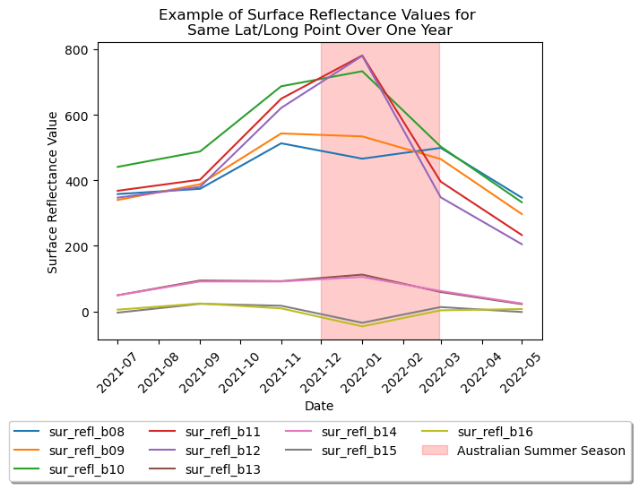
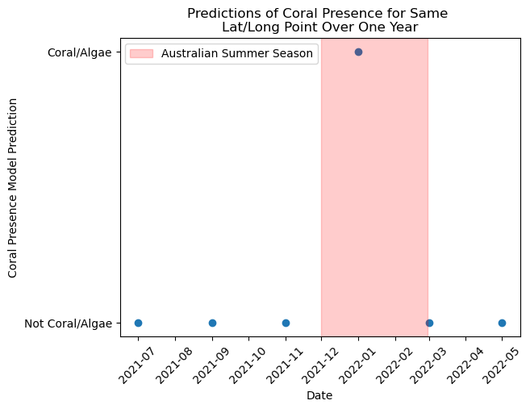
Distinguishing Between Coral and Algae
Algae is typically only present in the summer months
Idea: Take points predicted to be coral/algae and predict on the same location at different times throughout the year
Temporal, Voting-Based Classification: Areas where coral/algae presence is only predicted in the summer months are likely algae

Slide 18
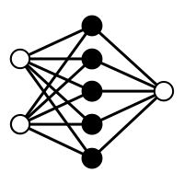
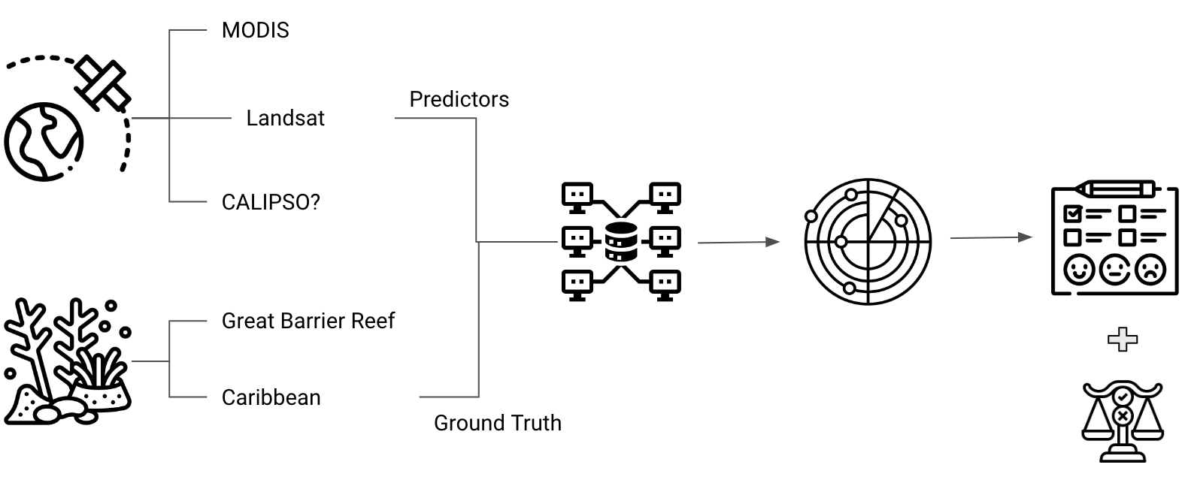

Distinguishing Between Coral and Algae
Temporal, Voting-Based Classification: Areas where predictions differ between summer and winter months are likely algae
In Practice: Weighted average of predicted probability of coral/algae presence at a single location over time
Less weight given to observations in the summer months due to inability to distinguish between coral and algae
Use of subject matter expertise to come up with a unique solution
Pull Satellite Data for Multiple Dates Over the Year
Single Location
Predict Probability of Coral Presence at Each Date
Compute Weighted Average Predicted Probability
Output Coral Presence Decision

Slide 19
MODEL 2: BLEACHING SEVERITY

Slide 20
Model 2 - Bleaching Severity

Slide 21
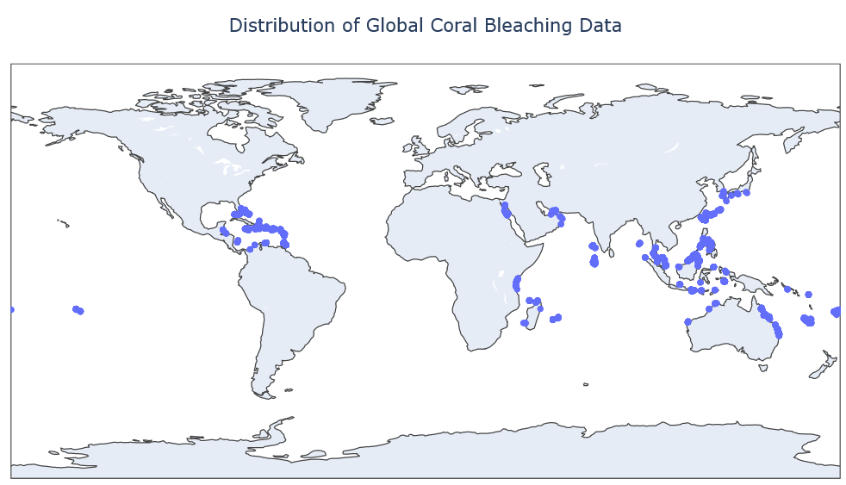
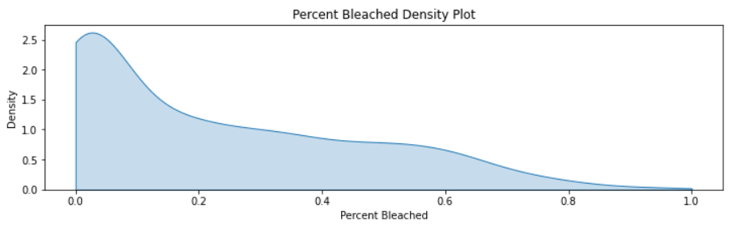
Model 2 - Bleaching Severity
Datasets
Global Coral Bleaching Database
Satellite Datasets: MODIS and Landsat-8 continue to be used in Model 2.
Coral Dataset: Global Coral Bleaching Database (GCBD)
34,846
Total GCBD
Total records in the Global Coral Bleaching Database
22,955
Usable Data from GCBD
Records available with useable bleaching values, filtered to the “Colony” Bleaching Level, and average values from multiple depths
4,753
Landsat 8 - Filter to After 2013
Landsat 8 started collecting data in 2013 so records taken before this year are removed
1,162
Region Specific Filter
Global models proved ineffective at accurately predicting bleaching levels. Region specific models further restrict available records

Slide 22
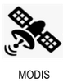
Model 2 - Bleaching Severity
1
Input 2 - MODIS Feature Engineering
SST - Sea Surface Temperatures POC - Particulate Organic Carbon
Chlor_A - Chlorophyll A NFLH - Normalized Fluorescence Line Height
SST max
Cumulative SST
MMM comparison
HotSpot
DHW
SST CV Max
SST Warming CV Max
Days above SST CV Threshold
chlor_a max
chlor_a min
chlor_a avg
chlor_a change
poc max
poc min
poc avg
poc change
nflh max
nflh min
nflh avg
nflh change
MMM = Maximum Monthly Mean Temperature for Coral Lat/Lon
HotSpot = SST - MMM
DHW = 12 week accumulated HotSpot when > 1°C
CV = 14 day Rolling Coefficient of Variation
CV Threshold = 1.9 (Bleaching predictor at lower temperatures)
Max = max(all observations for lat/long over 90-day period)
Min = min(all observations for lat/long over 90-day period)
Average = mean(all observations for lat/long over 90-day period)
Change = last - first observation
Notes:
mention that the other features are a set of surface reflectance bands

Slide 23
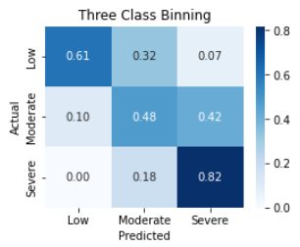
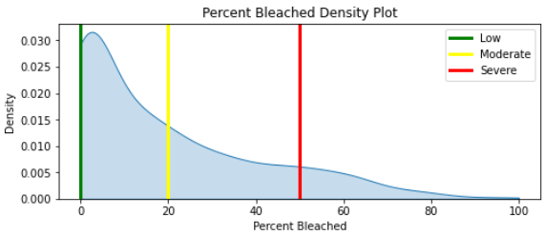
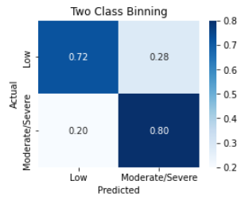
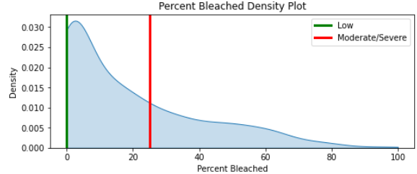
Model 2 - Bleaching Severity
1
Output 2 - Modeling Results
Three Class Binning
Weighted Precision
77.84%
Emphasizes severity classification
Still struggles with low to moderate bleaching
Weighted Recall
65.42%
Two Class Binning
Weighted Precision
96.94%
Maximizes precision
Chosen for final dashboard
Weighted Recall
72.08%

Slide 24
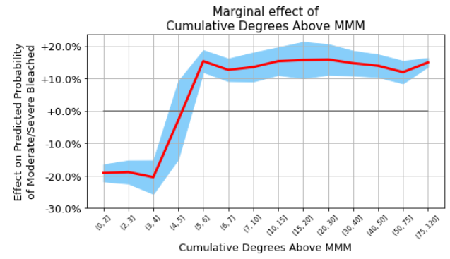
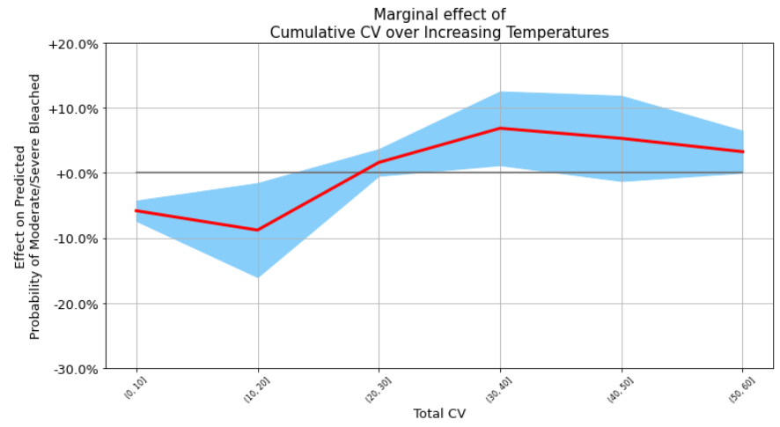
Model 2 - Bleaching Severity
1
Two Bin SHAP Analysis
Increased probability to predict bleaching as cumulative stress from rapid temperature growth rises
Changes in probability that our model will predict bleaching as cumulative sea surface temperature increases

Slide 25
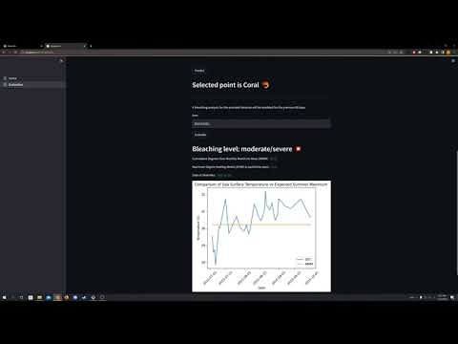
Final Product
The chosen latitude and longitude contains coral
Bleaching is predicted for October 1st 2015, lining up with a known bleaching event
Low bleaching is then predicted in 2022 implying that the area has since recovered

Slide 26
Conclusions / Key Insights
Coral / algae presence combined can be predicted with high accuracy (0.965 for Great Barrier Reef)
Limited data availability and the complexity of the problem led to unique and innovative solutions
Using temporal, voting-based classification to distinguish between coral and algae
Engineering features related to sea surface temperature and Chlorophyll A
Binning bleaching severity
A model built on a specific region does not extend well to other regions, caused in part by the diversity of coral species around the world
Bleaching prediction accuracy was maximized using two class binning with a threshold of 25%
This threshold was verified by coral experts as being a bleaching percentage that would cause concern

Slide 27
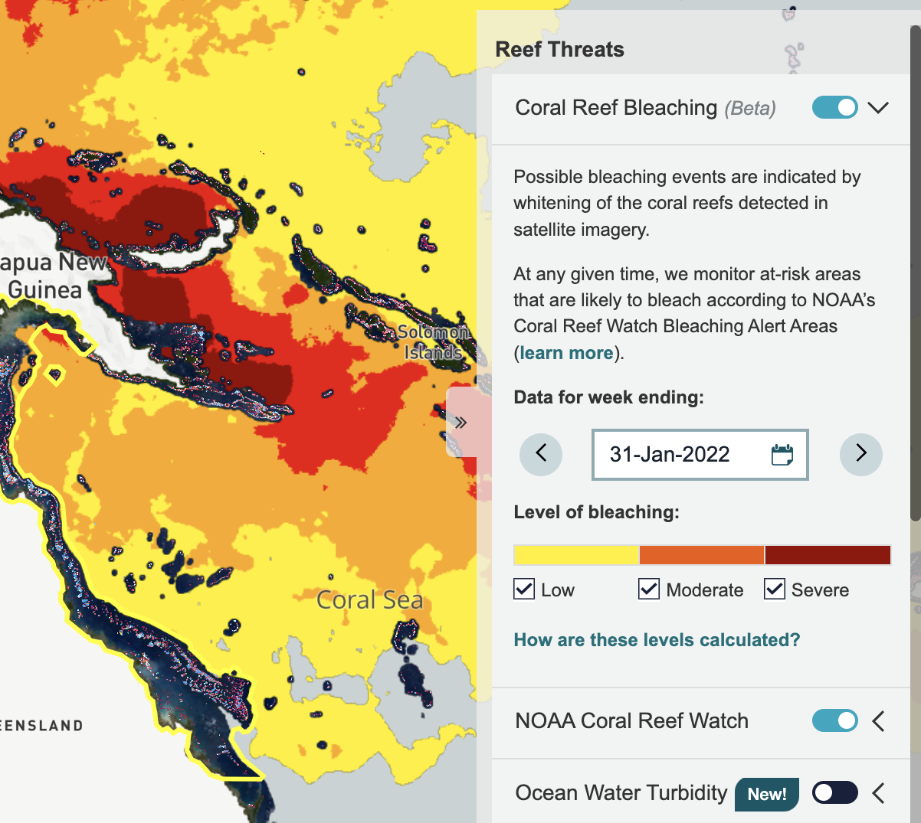
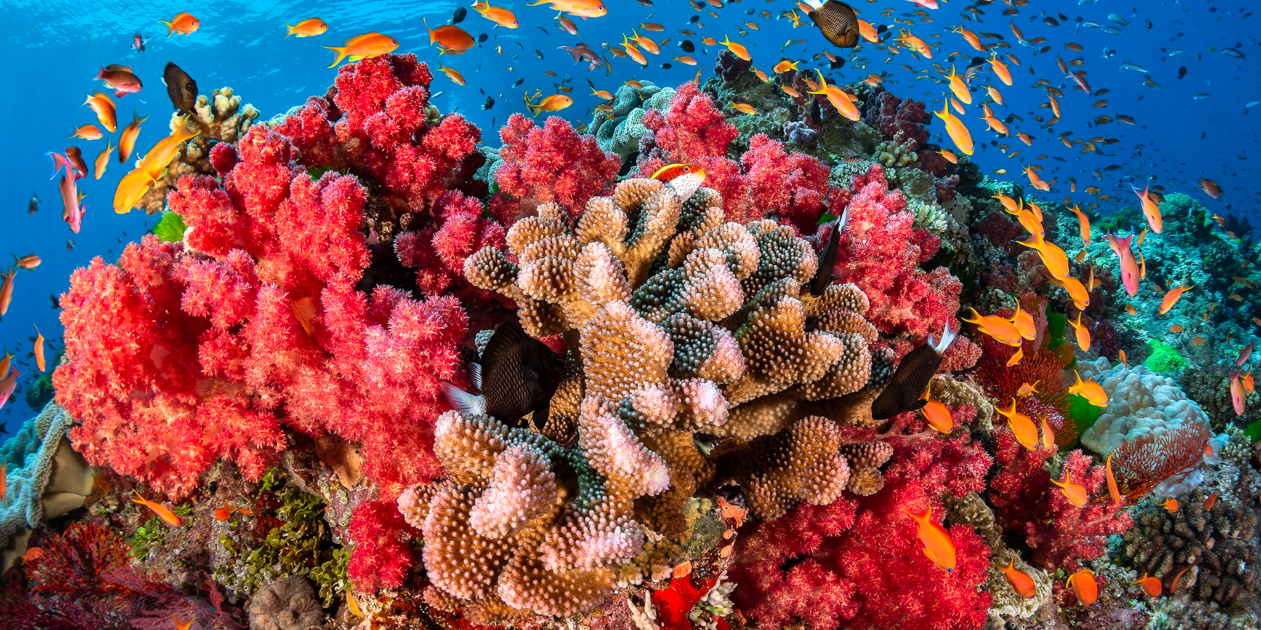
Limitations & Future Considerations
Challenges and Limitations
Next Steps / Future Research:
Limited and sparse data
Coral and algae having similar spectral signatures
Limited time on a project that requires heavy domain knowledge
Models built on one region do not extend well to other regions
Potential to add more features
Allen Coral Atlas bleaching is currently in beta
Exploring other regions
Verifying with ground truth points
Screenshot Showing Bleaching Features in Beta from Coral Atlas Website
Image of Coral Reefs in Great Barrier Reef

Slide 28
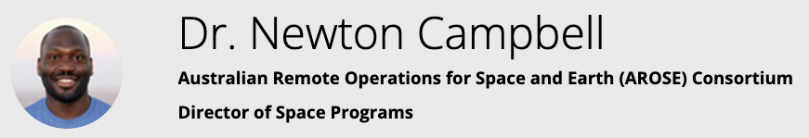


Highlight: COP27- UN Climate Change Convention
Risk mapping and climate vulnerability across the world
Nov 17, 2022
INTRODUCTION & PROJECT LOGISTICS
Notes:
Before diving into our introduction, we just want to take a minute to highlight that our work was actually presented at COP27 earlier in November. Dr. Campbell gave an extensive presentation on risk mapping and climate vulnerability across the world, including the work done by our team and others who worked on coral health with NASA last year. Our project will also be published in detail for others to use it as a starting point for future research on this topic.

Slide 29




Acknowledgements
We would like to thank the following individuals for their collaboration in guiding and supporting our efforts:
NASA and AROSE:
Douglas Trent, Aimeé Gibbons, and Newton Campbell
Florida Keys National Marine Sanctuary and Coral Vita:
Katey Lesneski and Joe Oliver
University of Rochester:
Ajay Anand and Cantay Caliskan
Georgia Tech:
Previous Capstone Team

Slide 30
Thank you
Questions?

